Slide 1

Understanding Kernels in SVM
Kernels are mathematical engines that enable Support Vector Machines (SVMs) to handle complex, nonlinear patterns. They transform data to find clear boundaries where none seemed to exist.

Slide 2
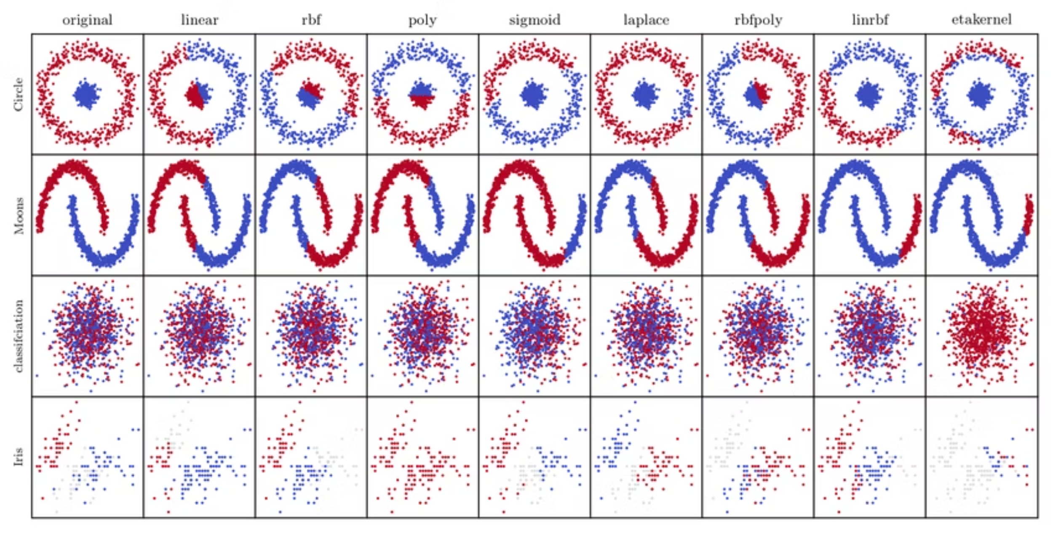
Why Do We Need Kernels?
The Challenge
Real-world data is rarely linearly separable. Datasets like 'moons' or 'circles' cannot be divided by a straight line.
Linear classifiers struggle with: curved boundaries, intertwined class distributions, and complex multidimensional structures.
Kernels are vital, enabling SVMs to tackle complex, nonlinear real-world classification challenges.

Slide 3
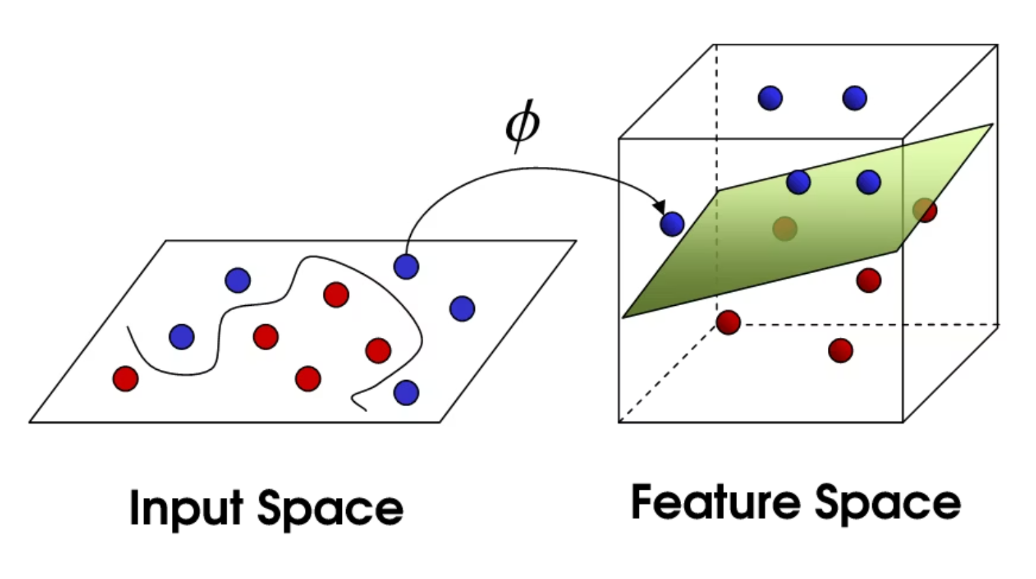
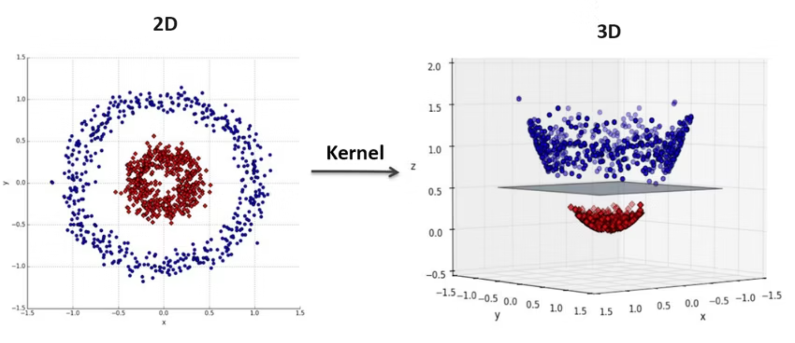
The Kernel Trick
"We pretend to project data into a higher dimension without actually doing it."
The kernel trick avoids explicit high-dimensional calculations by computing inner products directly in the original space. This mathematical shortcut makes complex transformations computationally feasible, offering the power of high-dimensional separation while maintaining original computational cost.

Slide 4


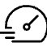
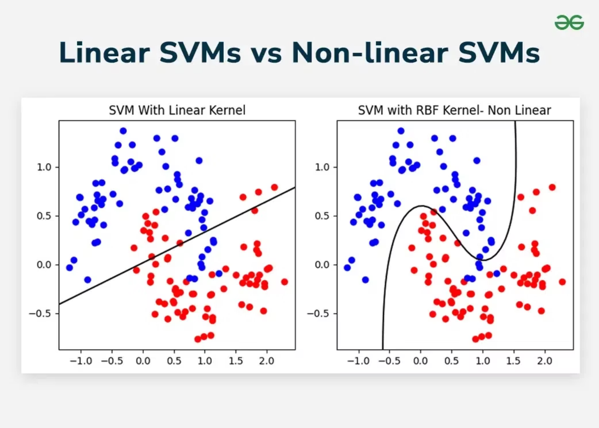
Linear Kernel: The Foundation
Simple Boundary
When to Use
Performance
Creates a straight decision boundary
Data is linearly separable
Fastest to train and predict
Defined as K(x, y) = xTy, it's equivalent to standard SVM without transformation. It's the baseline for high-dimensional data like text classification.
Despite its simplicity, it performs exceptionally well when features capture relevant patterns in sparse, high-dimensional spaces.

Slide 5
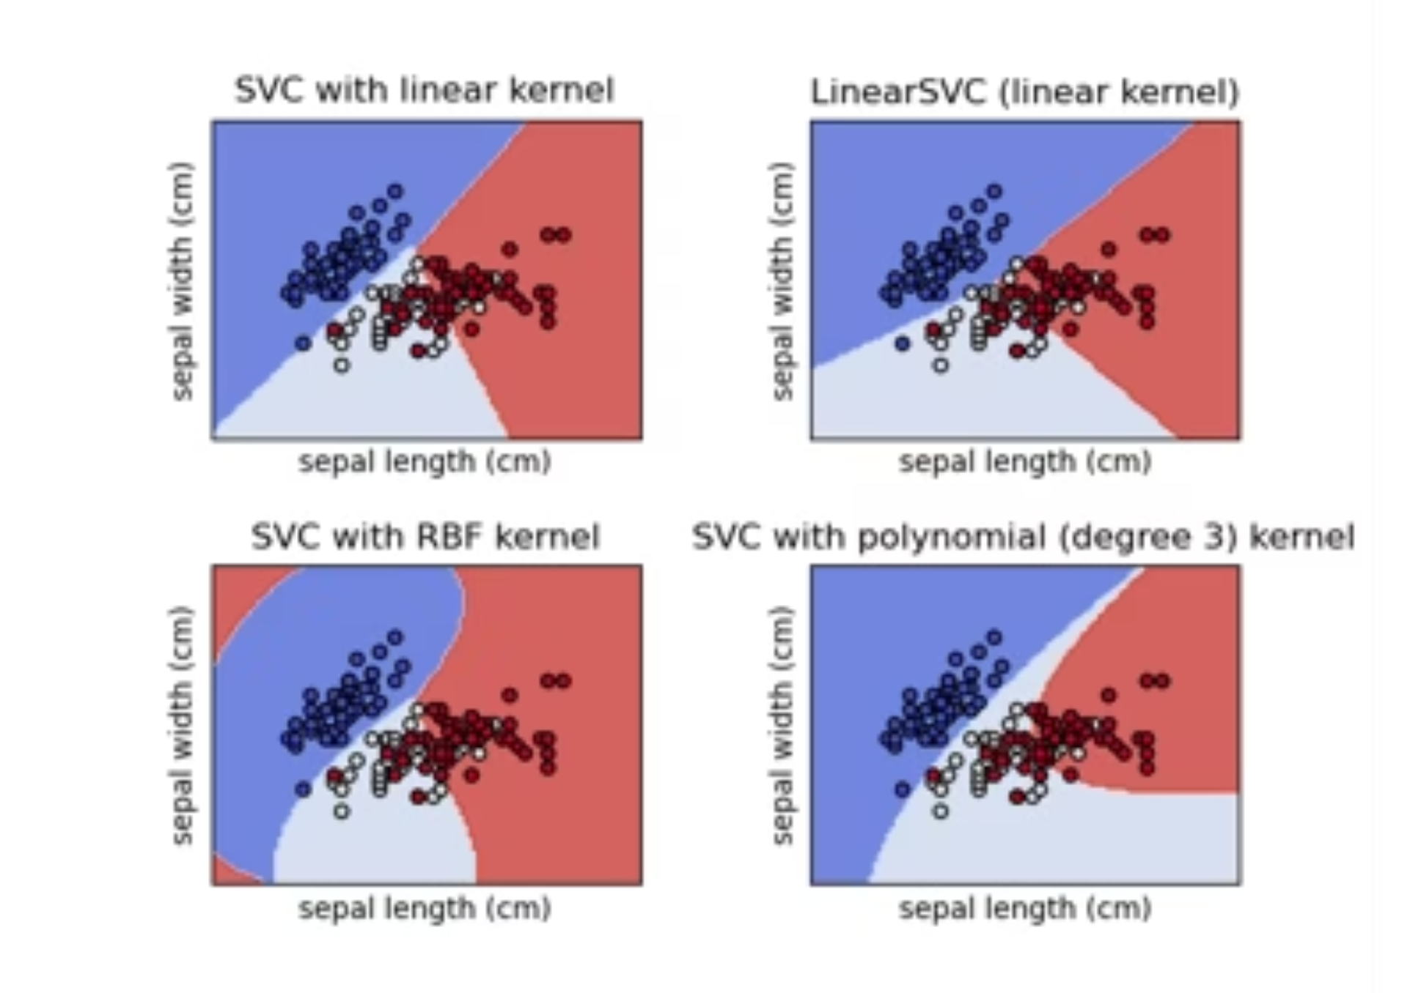



Polynomial Kernel: Controlled Complexity
Degree 2
Creates gentle curves; suitable for moderately nonlinear patterns.
Degree 3
Captures intricate patterns; balances flexibility and generalization.
Higher Degrees
Increases model capacity but risks severe overfitting. Use with caution.
Defined as K(x, y) = (xTy + c)d, this kernel is effective when polynomial relationships are suspected in data.

Slide 6

Polynomial Kernel: Trade-offs
✓ Advantages
⚠ Challenges
Captures polynomial feature interactions
High degrees risk overfitting
Interpretable with clear degree
Numerical instability
Effective for smooth patterns
Sensitive to feature scaling
Efficient for low degrees
Requires careful tuning
Best Practice: Start with degree 2 or 3. Higher degrees often overfit. Use cross-validation to select degree.

Slide 7


RBF Kernel: The Adaptive Powerhouse
The RBF (Gaussian) kernel is the most popular choice for nonlinear SVM. It measures similarity via Euclidean distance, creating localized influence around support vectors.
Infinite Dimensions
Maps data to infinite-dimensional space, offering flexibility for any nonlinear pattern.
Local Influence
Support vectors influence nearby points, creating adaptive boundaries.
Shape Adaptation
Adjusts to irregular class shapes and complex geometries without explicit feature engineering.
Defined as K(x, y) = exp(-γ||x - y||²), with γ controlling influence radius. Its versatility makes it the default for nonlinear classification.

Slide 8

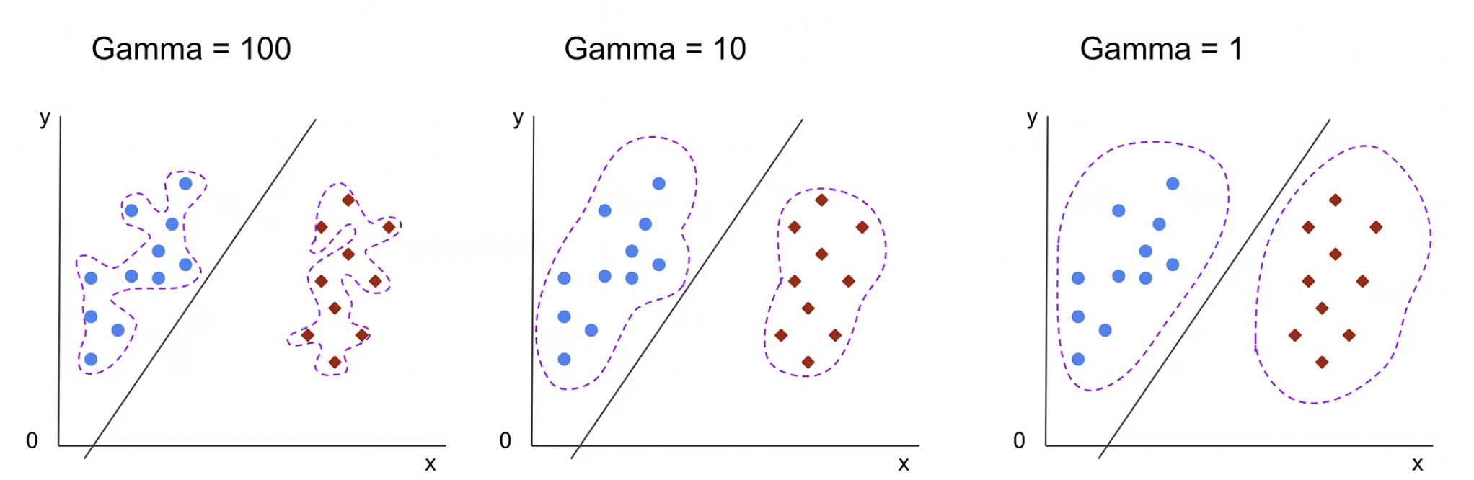
The Gamma Parameter: Precision Control
Low Gamma
High Gamma
Wide influence
Narrow influence
Affects distant points
Affects only nearby points
Smooth, generalized boundaries
Intricate, detailed boundaries
Reduces overfitting
Captures subtle patterns
Risk of underfitting
Risk of overfitting
Like a wide brush: broad strokes, misses fine details.
Like a fine-tip pen: precise, but can memorize noise.
Rule of thumb: Start with gamma = 1/n_features and tune using cross-validation. Monitor both training and validation accuracy to detect overfitting.

Slide 9





Kernel Selection Guide
Analyze Your Data First
Try Linear First
RBF for Complex Patterns
Visualize relationships and understand problem structure before choosing a kernel.
Fast, interpretable, and often sufficient for high-dimensional or text data.
Best for nonlinear data with unknown structure; adapts to most patterns.
Polynomial for Known Structure
Validate and Compare
Use when domain expertise suggests specific polynomial relationships. Start with low degrees (2-3).
Use cross-validation to compare kernel performance. Best kernel depends on data characteristics.

